Slide 1
CS 316: Introduction to Deep Learning
Vector Calculus
Week 3
Dr Abdul Samad

Slide 2
Lecture Outline
Scalar derivatives
Vector calculus and partial derivatives
Chain rule
Matrix calculus

Slide 3

Common Derivatives
$\frac{d}{dx} c=0$
$\frac{d}{dx}\left(ax\right)=a$
$\frac{d}{dx} x^{n}=nx^{n−1}$
$\frac{d}{dx} e^{x}=e^{x}$
$\frac{d}{dx}\log\left(x\right)=\frac{1}{x}$

Slide 4
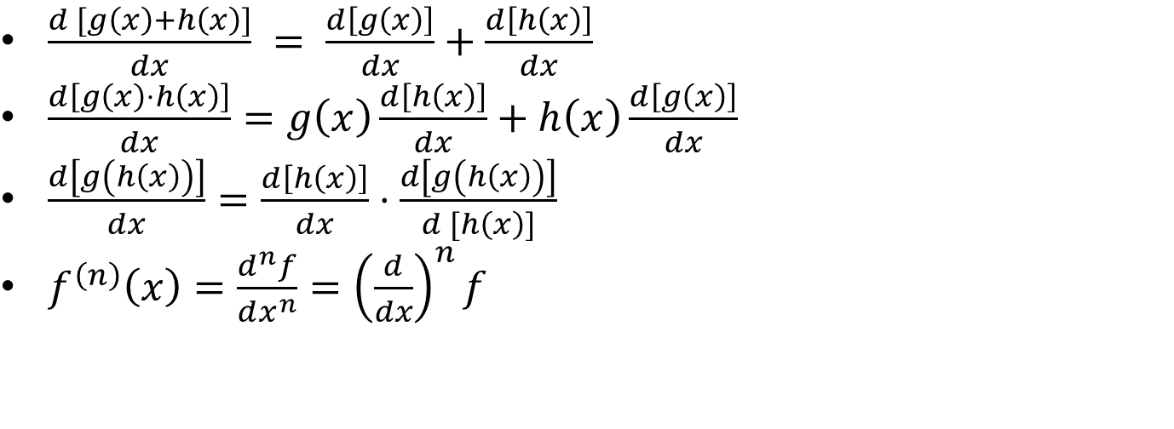
Derivative Rules
$\frac{d [g\left(x\right)+h\left(x\right)]}{dx} = \frac{d\left[g\left(x\right)\right]}{dx}+\frac{d\left[h\left(x\right)\right]}{dx}$
$\frac{d\left[g\left(x\right)⋅h\left(x\right)\right]}{dx}=g\left(x\right)\frac{d\left[h\left(x\right)\right]}{dx}+h\left(x\right)\frac{d\left[g\left(x\right)\right]}{dx}$
$\frac{d\left[g\left(h\left(x\right)\right)\right]}{dx}=\frac{d\left[h\left(x\right)\right]}{dx}⋅\frac{d\left[g\left(h\left(x\right)\right)\right]}{d [h\left(x\right)]}$
$f^{\left(n\right)}\left(x\right)=\frac{d^{n}f}{dx^{n}}={\left(\frac{d}{dx}\right)}^{n}f$

Slide 5
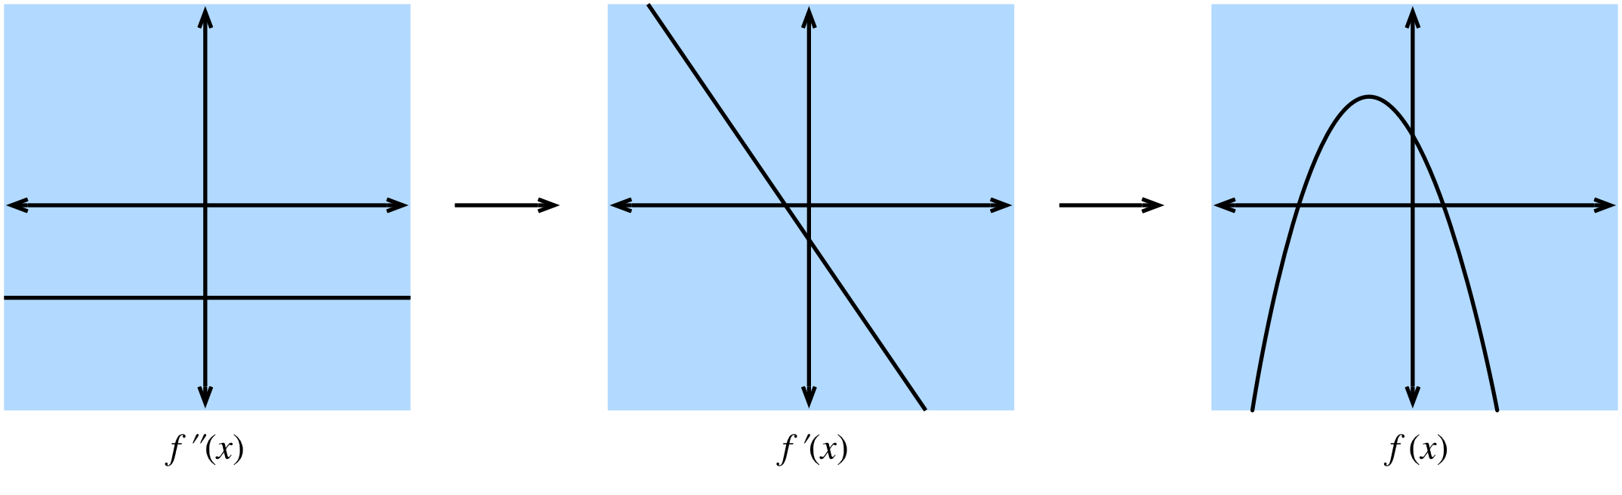

Visualising Derivatives - Minimum
$f^{2}\left(x\right)$is a positive constant.
$f^{1}\left(x\right)$ is increasing.
$f\left(x\right)$ has a minimum.
Figure taken from d2l.ai

Slide 6
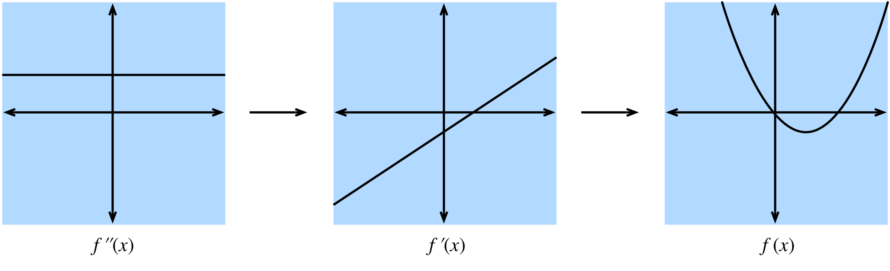

Visualising Derivatives - Maximum
$f^{2}\left(x\right)$is a negative constant.
$f^{1}\left(x\right)$ is decreasing.
$f\left(x\right)$ has a maximum.
Figure taken from d2l.ai

Slide 7
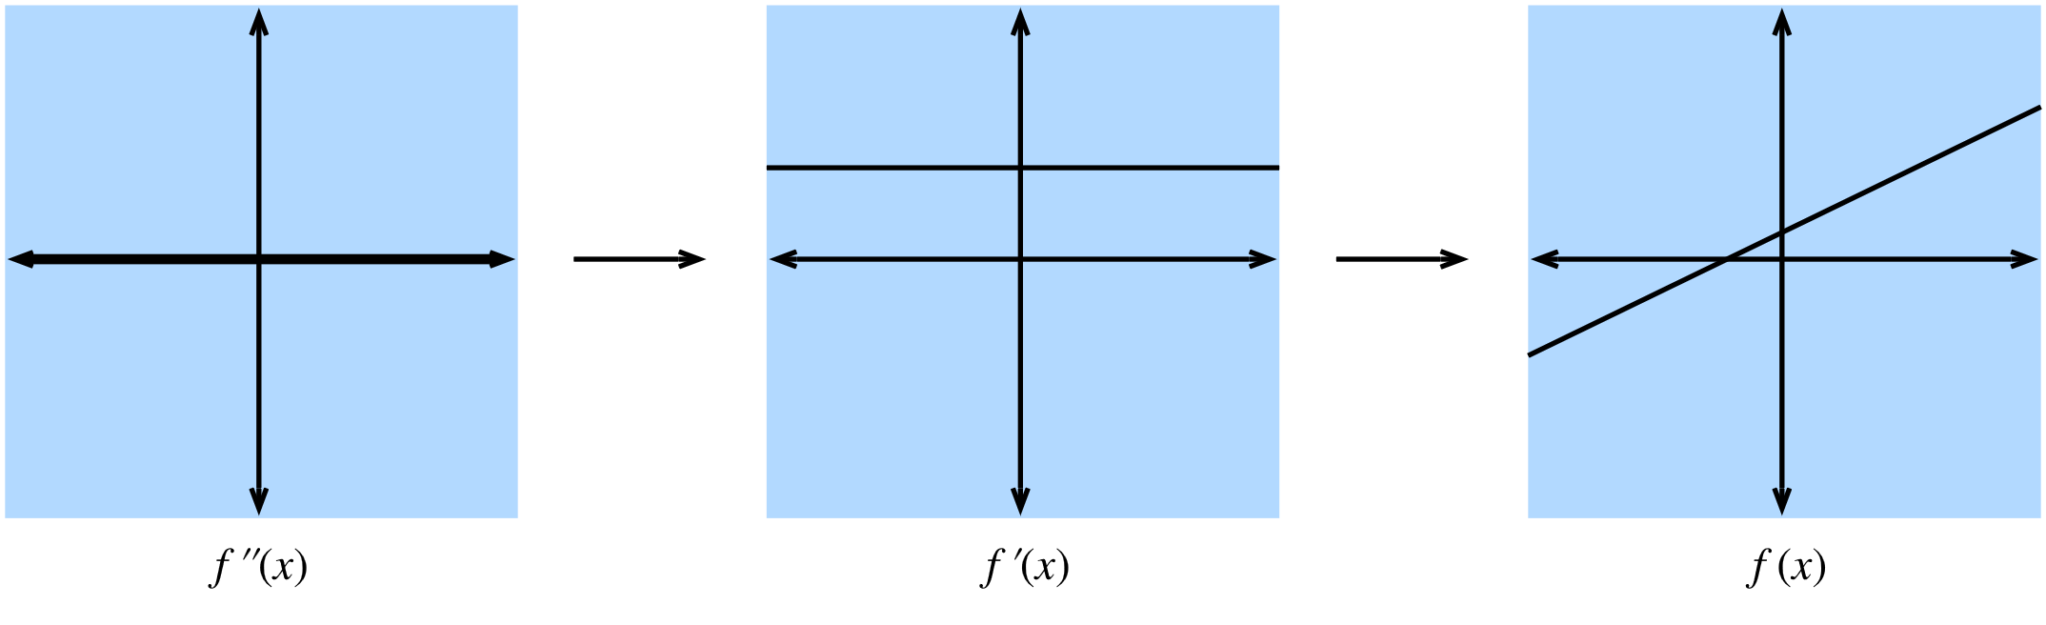

Visualising Derivatives - Linear
$f^{2}\left(x\right)$is zero.
$f^{1}\left(x\right)$ is constant.
$f\left(x\right)$ is a straight line.
Figure taken from d2l.ai

Slide 8
Sub derivative
Extend derivative to non-differentiable cases

Slide 9
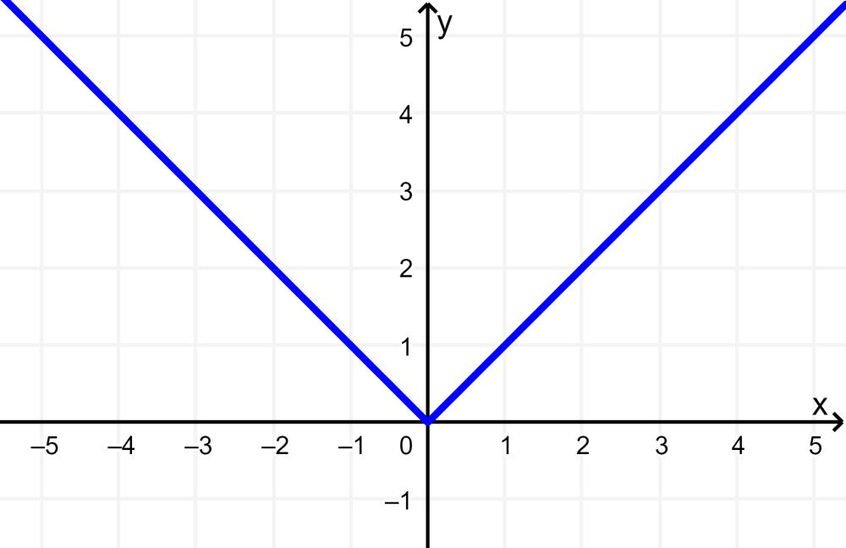
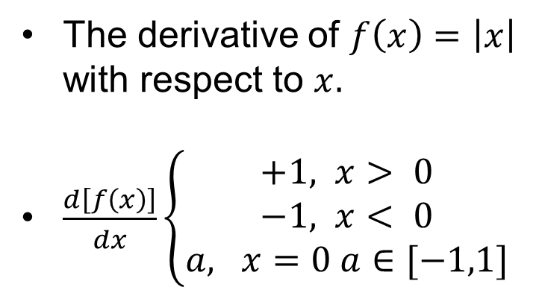
Sub derivative - 1
The derivative of $f\left(x\right)=\left|x\right|$ with respect to $x.$
$\frac{d\left[f\left(x\right)\right]}{dx}\left\{\begin{aligned}+1, x> 0 \\ &−1, x< 0 \\ a, x=0 a∈[−1,1]\end{aligned}\right.$

Slide 10
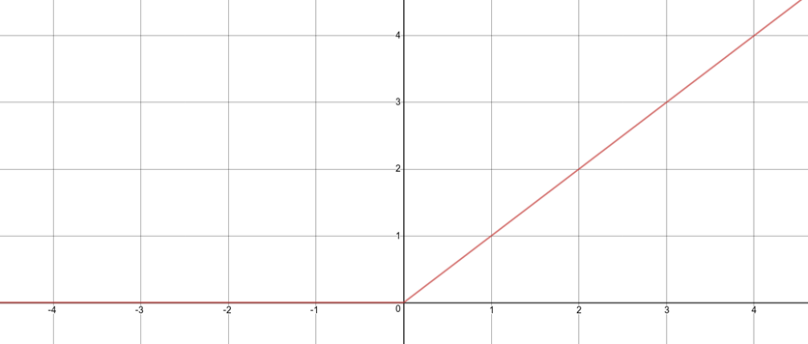
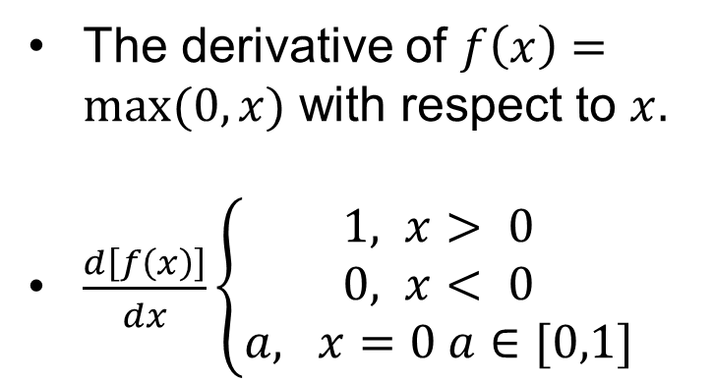
Sub derivative - 2
The derivative of $f\left(x\right)=max⁡(0,x)$ with respect to $x.$
$\frac{d\left[f\left(x\right)\right]}{dx}\left\{\begin{aligned}1, x> 0 \\ &0, x< 0 \\ a, x=0 a∈[0,1]\end{aligned}\right.$

Slide 11
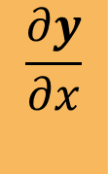







Vector Calculus
Generalize derivatives into vectors.
Scalar Vector
$$x$$
$$x$$
Scalar
Vector
$$\frac{∂y}{∂x}$$
$$\frac{∂y}{∂x}$$
$$y$$
$$y$$
$$\frac{∂y}{∂x}$$
$$\frac{∂y}{∂x}$$

Slide 12

Common Derivatives
$\frac{∂}{∂x} c=0^{T}$
$\frac{d}{dx}\left(ax\right)=a$I
$\frac{∂}{∂x}sum(x)=1^{T}$
$\frac{∂}{∂x}{\left\|x\right\|}_{2}^{2}=2x^{T}$

Slide 13
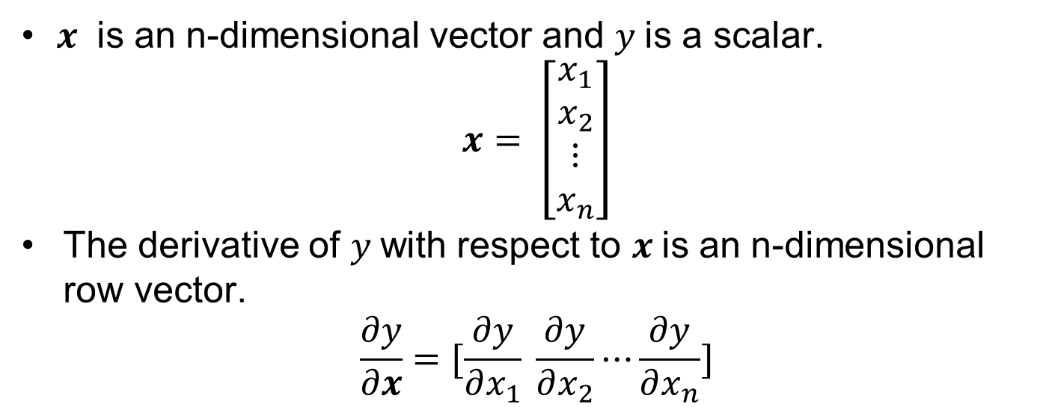

$$\frac{∂y}{∂x}$$
$x$ is an n-dimensional vector and $y$is a scalar.
$$x= \left[\begin{matrix}x_{1} \\ x_{2} \\ \begin{aligned}⋮ \\ x_{n}\end{aligned}\end{matrix}\right]$$
The derivative of $y$with respect to $x$is an n-dimensional row vector.
$$\frac{∂y}{∂x}=[\frac{∂y}{∂x_{1}} \frac{∂y}{∂x_{2}}⋯\frac{∂y}{∂x_{n}}]$$

Slide 14
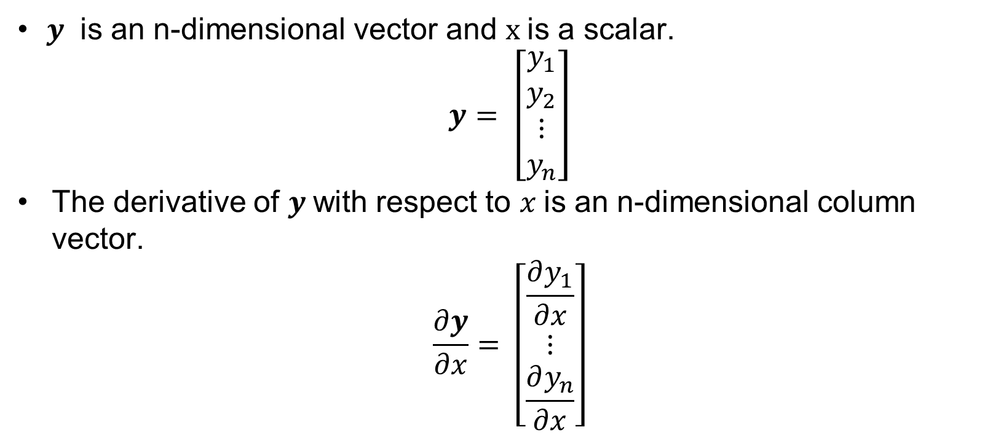

$$\frac{∂y}{∂x}$$
$y$ is an n-dimensional vector and $x$is a scalar.
$$y= \left[\begin{matrix}y_{1} \\ y_{2} \\ \begin{aligned}⋮ \\ y_{n}\end{aligned}\end{matrix}\right]$$
The derivative of $y$with respect to $x$is an n-dimensional column vector.
$$\frac{∂y}{∂x}= \left[\begin{matrix}\frac{∂y_{1}}{∂x} \\ ⋮ \\ \frac{∂y_{n}}{∂x}\end{matrix}\right]$$

Slide 15
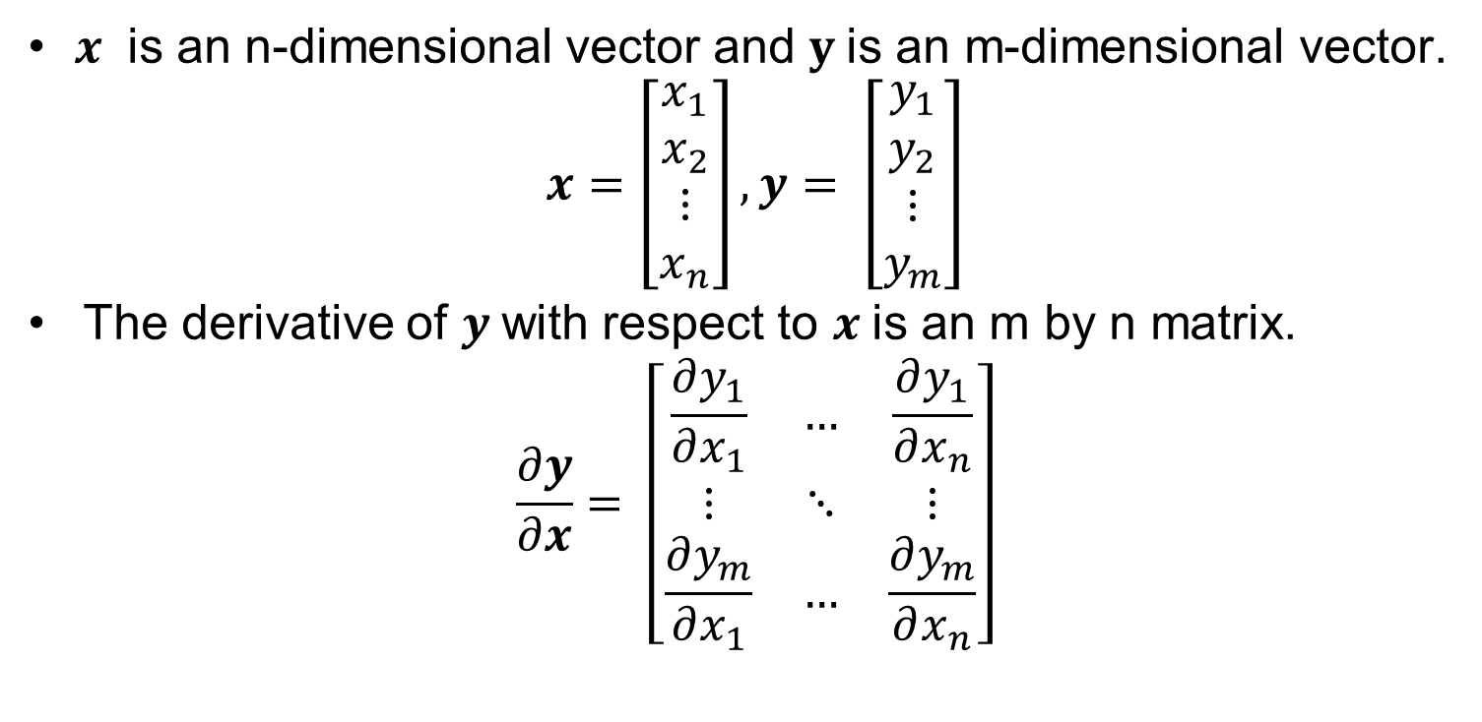

$$\frac{∂y}{∂x}$$
$x$ is an n-dimensional vector and $y$is an m-dimensional vector.
$$x=\left[\begin{matrix}x_{1} \\ x_{2} \\ \begin{aligned}⋮ \\ x_{n}\end{aligned}\end{matrix}\right], y= \left[\begin{matrix}y_{1} \\ y_{2} \\ \begin{aligned}⋮ \\ y_{m}\end{aligned}\end{matrix}\right]$$
The derivative of $y$with respect to $x$is an m by n matrix.
$$\frac{∂y}{∂x}= \left[\begin{matrix}\frac{∂y_{1}}{∂x_{1}} & … & \frac{∂y_{1}}{∂x_{n}} \\ ⋮ & ⋱ & ⋮ \\ \frac{∂y_{m}}{∂x_{1}} & … & \frac{∂y_{m}}{∂x_{n}}\end{matrix}\right]$$

Slide 16
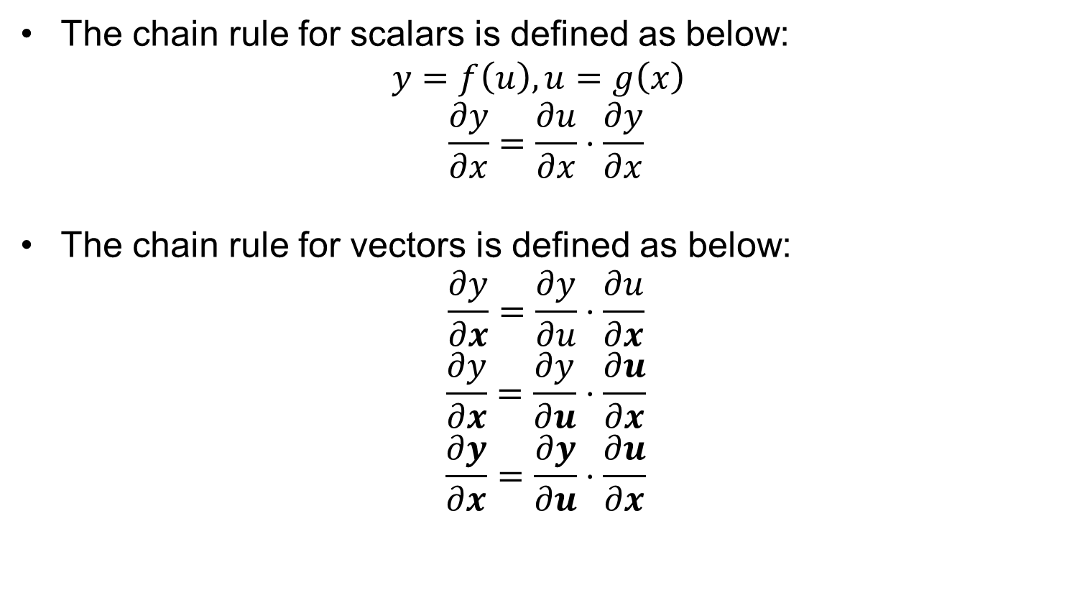
Chain Rule
The chain rule for scalars is defined as below:
$$y=f\left(u\right), u=g\left(x\right)$$
$$\frac{∂y}{∂x}=\frac{∂u}{∂x}⋅\frac{∂y}{∂x}$$
The chain rule for vectors is defined as below:
$$\frac{∂y}{∂x}=\frac{∂y}{∂u}⋅\frac{∂u}{∂x}$$
$$\frac{∂y}{∂x}=\frac{∂y}{∂u}⋅\frac{∂u}{∂x}$$
$$\frac{∂y}{∂x}=\frac{∂y}{∂u}⋅\frac{∂u}{∂x}$$

Slide 17















Generalize to Matrices
Scalar
Vector
Matrix
$$x$$
$$X$$
$$x$$
$$\frac{∂y}{∂x}$$
$$\frac{∂y}{∂X}$$
Scalar
Vector
Matrix
$$y$$
$$\frac{∂y}{∂x}$$
$$y$$
$$\frac{∂y}{∂x}$$
$$\frac{∂y}{∂x}$$
$$\frac{∂y}{∂X}$$
$$Y$$
$$\frac{∂Y}{∂x}$$
$$\frac{∂Y}{∂x}$$
$$\frac{∂Y}{∂X}$$

Slide 18
References
https://explained.ai/matrix-calculus/
https://d2l.ai/chapter_preliminaries/calculus.html
https://d2l.ai/chapter_appendix-mathematics-for-deep-learning/single-variable-calculus.html
https://d2l.ai/chapter_appendix-mathematics-for-deep-learning/multivariable-calculus.html

